Slide 1
Project: Laptop Price prediction
Bilal farooq
P229288
BS-AI-3A

Slide 2
Intro
I chose this project to explore how machine learning can predict laptop prices based on their specifications. Laptop prices vary significantly due to features like RAM, screen resolution, and processors, making it essential to understand these factors. Using a Decision Tree model, I analyzed a dataset of laptop specs and prices, focusing on cleaning and standardizing the data for accuracy. The goal was to build a tool that helps users estimate laptop prices efficiently, empowering better buying and selling decisions.

Slide 3
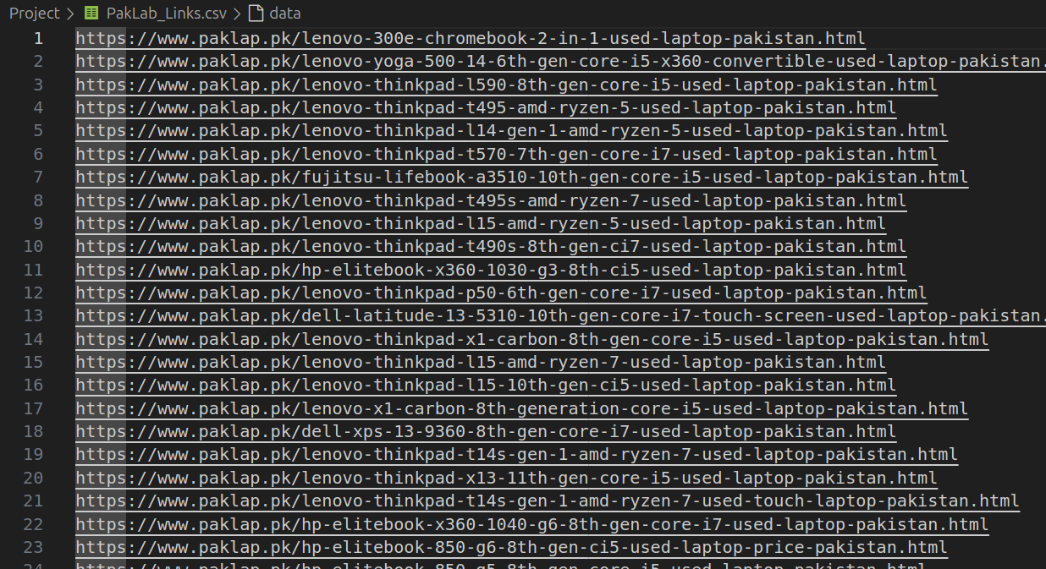
First point
Data Extraction
Data Source: Combined datasets from Paklab and Mega.pk.
Extracted Links:
Mention the types of links extracted (e.g., product listings, specifications).

Slide 4
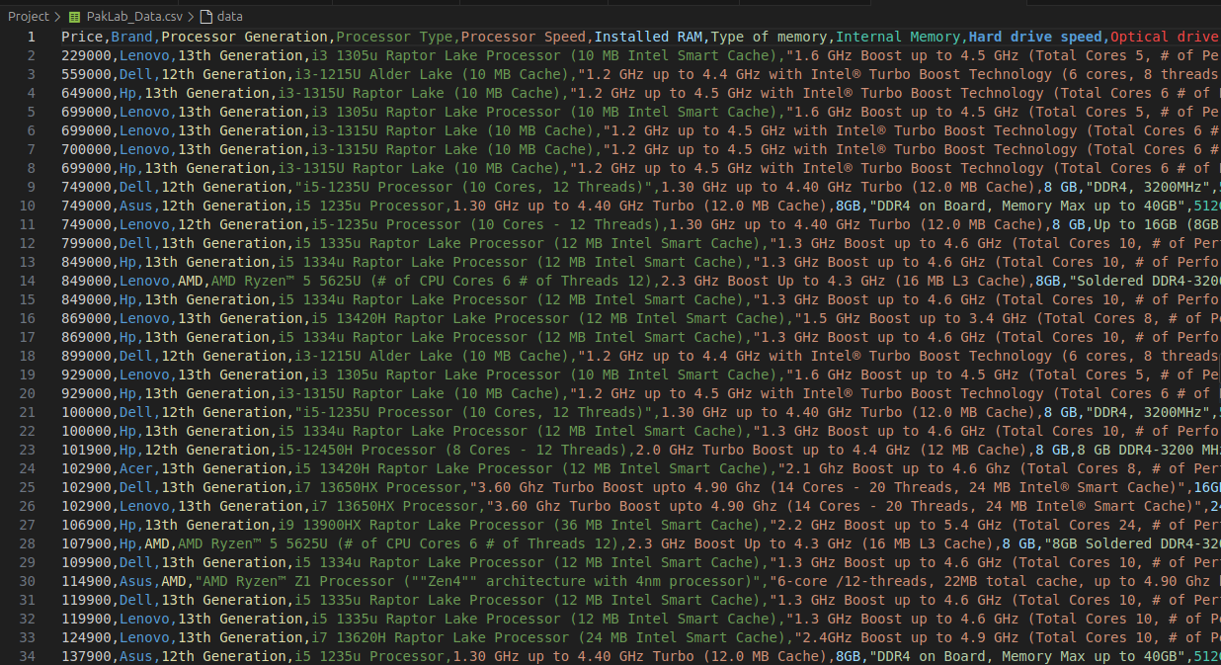
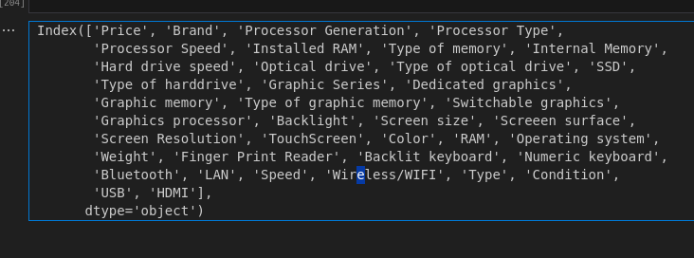
Second Point
Product Information Extraction
I extracted all the product specifications from the first link, including details like brand, model, price, and specifications.
I repeated this process for another link to gather more data.
After extracting the information from both links, I saved all the product specifications in a CSV file for further analysis.

Slide 5

Third Point
Data Preprocessing
I preprocessed all the data from both files, "Pak Lab" and "Mega," to ensure consistency and accuracy.
This included cleaning the data, handling missing values, and formatting specifications for easier analysis.

Slide 6
Fourth Point
Data Merging and Additional Preprocessing
Merging Data:
After preprocessing, I merged the cleaned data from both "Pak Lab" and "Mega" into a single CSV file.
This step allowed me to combine all product specifications into one comprehensive dataset.
Additional Preprocessing:
I applied further preprocessing to the merged data to ensure it was ready for analysis. This included renaming columns and removing any duplicates.
Exploratory Data Analysis:
Visualized key features using plots to understand distributions and relationships.
Identified and handled outliers by applying the IQR (Interquartile Range) method.

Slide 7
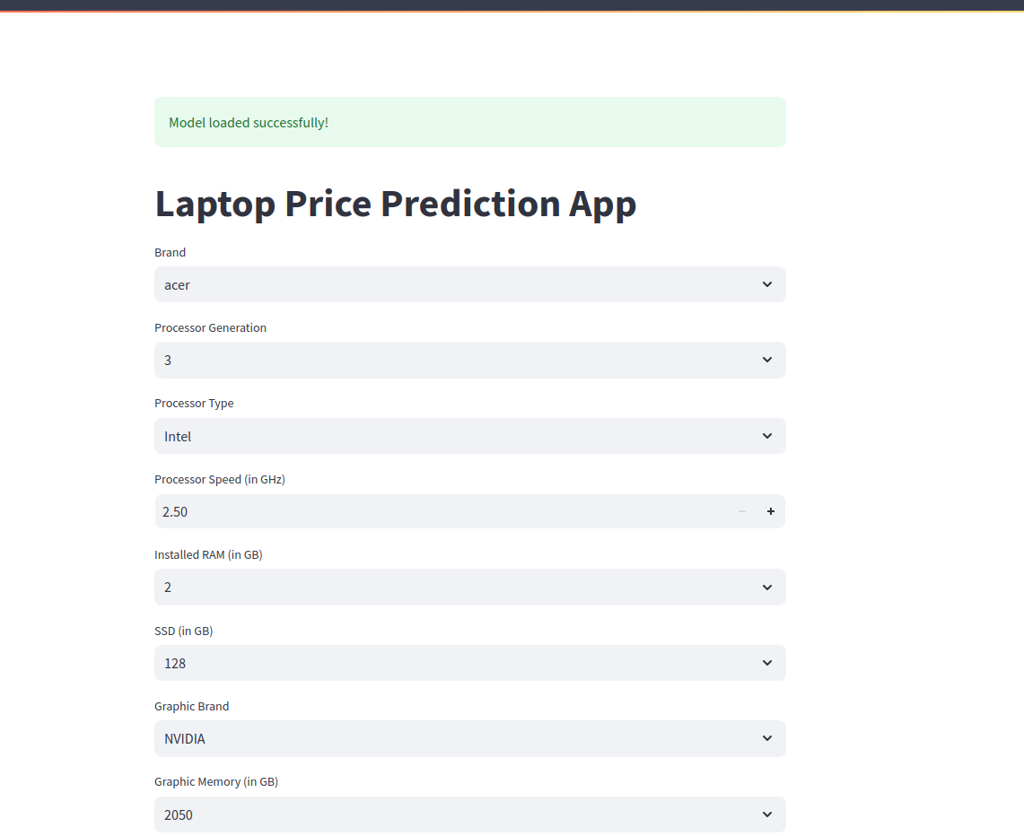
Used Steamlite to show the final result on Laptop Price Prediction App

Slide 8
Final point
Model Selection:
Used Decision Trees to train the model due to its ability to work effectively with the limited dataset size and its interpretability.

Slide 9

Thank You!

